Slide 1

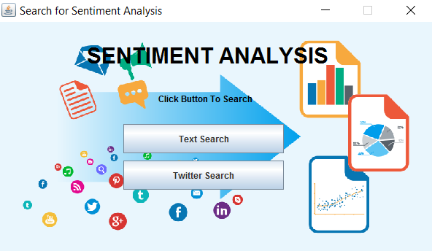
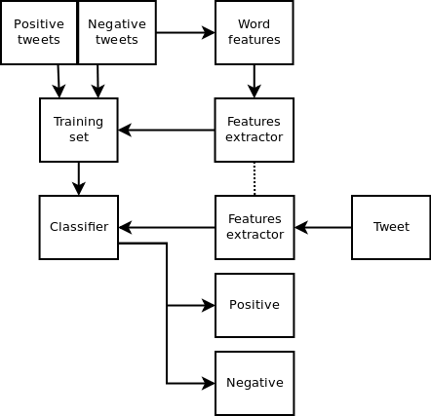
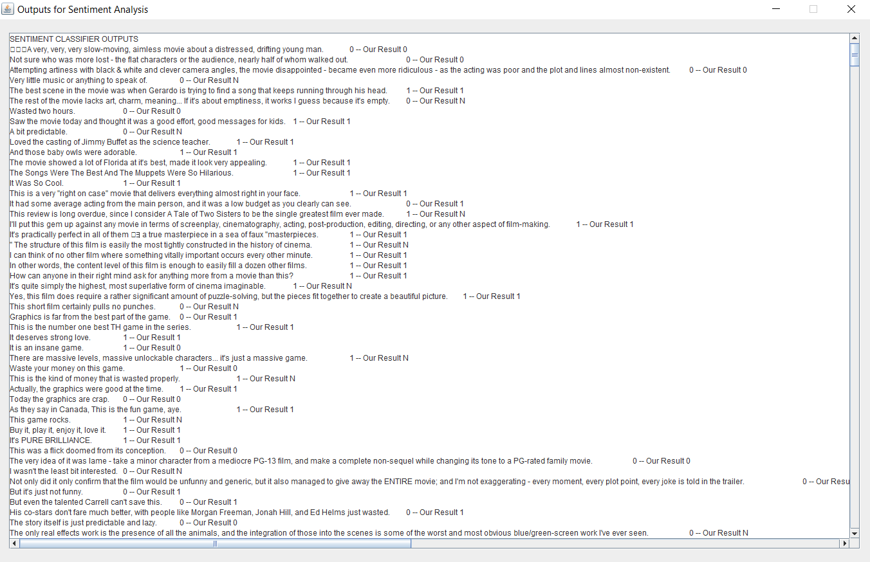
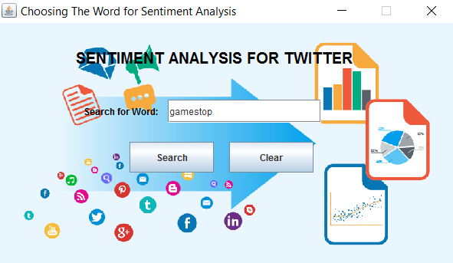
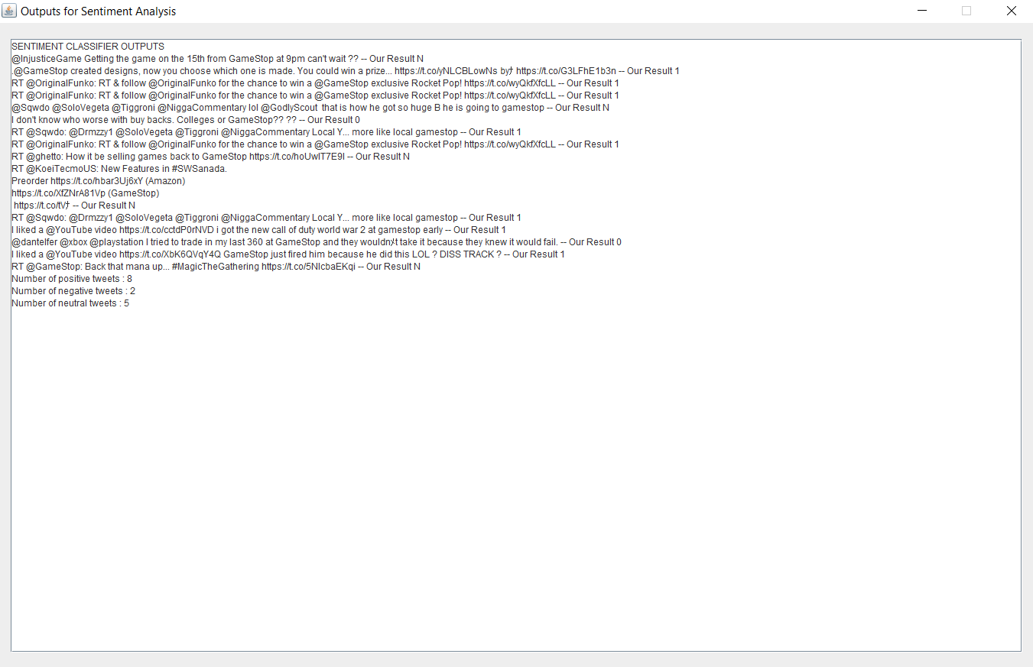
Sentiment Analysis
Cem Konuk Yunus Emre Aydar
Supervisor Ph.D Tevfik Aytekin
Faculty of Engineering and applied Sciences,
Department of Computer Engineering, Bahçeşehir University.
Description
Sentiment analysis is the process of analyzing natural language text to determine users' opinions or emotions (e.g., positive, negative, or neutral) on specific topics or products. The aim of this project is to collect tweets from the Twitter stream (along with other datasets) and perform basic sentiment analysis.
Searching Options for Sentiment Analysis
Flow Chart of Sentiment Analysis
System of Project
There are two options for performing sentiment analysis: Text Search and Twitter Search.
Text Search provides sentiment ratings for comments extracted from text documents. The image on the right shows an example of sentiment ratings for IMDb comments.
Twitter Search analyzes sentiment based on keyword searches on Twitter. The following images illustrate sentiment ratings for the keyword 'GameStop' on Twitter."
Conclusion
The goal of this project is to retrieve tweets for a specific keyword from Twitter and determine whether they are positive, negative, or neutral. Additionally, we have included a neutral classification in the sentiment analysis results. The primary language of our system is English. Optionally, we have also implemented a feature to analyze sample sentences from text documents.

